Slide 1
Messy Data: Cleaning,
Correlation & Visualisation
MSE-803 Data Analytics | Week 3 — Activity 2
Pathuma Hiruni
1 May 2026
MSE-803 Data Analytics | Yoobee College

Slide 2
About This Task
Dataset
Goal
Tools
Output
📁
🎯
🛠
📊
messy_dataset_Mukesh.csv
10 rows, multiple quality issues
Clean messy data & find if
Age is connected to Salary
Python · Pandas · NumPy
Seaborn · Matplotlib · OpenPyXL
Cleaned data + 6 charts
5-sheet Excel workbook
Key Question
"Is Age connected to Salary? If older, do employees earn more?"
MSE-803 Data Analytics | Week 3 Activity 2

Slide 3
Problems Found in Raw Data
# | Problem | Example | How Fixed
1 | Duplicate row | Bob appears 2 times | Second Bob removed
2 | Missing Age (×2) | Empty cells | Filled with median: 29
3 | Missing Salary (×2) | Empty cells | Filled with median: $62,000
4 | Age written as word | "thirty-eight" | Converted to 38
5 | Salary written as word | "sixty five thousand" | Converted to 65,000
6 | Broken date | 2019-13-01 (month = 13!) | Marked as Unknown
7 | Missing Join Date | Empty cell | Marked as Unknown
8 | Missing Name | Empty cell | Filled as Unknown
9 | Missing ID | Eve has no ID | Assigned ID: 6
10 | Missing Country | Empty cell | Marked as Unknown
Before: 10 rows with many problems → After: 9 clean rows ✓

Slide 4
Code Structure
Section 1
Section 2
Section 3
Section 4
Section 5
Section 6
Raw Data
Issues Log
Data Cleaning
Statistics
Charts
Excel Workbook
Read CSV file from disk
Document every problem found
Fix all messy problems step by step
Pearson correlation + IQR outlier detection
Build and save 6 PNG charts
Write everything into 5 formatted sheets
Helper Functions
apply_header() style_cell() set_col_widths() iqr_outliers()
Pipeline Flow
CSV Input → Clean Data → Pearson Correlation → IQR Outliers → 6 Charts → 5-Sheet Excel Workbook
MSE-803 Data Analytics | Week 3 Activity 2

Slide 5
How the Data Was Cleaned
Step 1 — Fix Text-as-Number
Step 2 — Remove Duplicate (Bob)
df['Age'] = df['Age'].replace('thirty-eight', '38')
df['Salary'] = df['Salary'].replace('sixty five thousand', '65000')
df.loc[1, 'Age'] = 30
df = df.drop(index=2).reset_index(drop=True)
Step 3 — Fix Missing / Broken Values
Step 4 — Fill Missing Numbers with Median
df['Name'] → filled with 'Unknown'
df['Join Date'] 2019-13-01 → 'Unknown'
df['Country'] empty cells → 'Unknown'
Age median = 29 years
Salary median = $62,000
MSE-803 Data Analytics | Week 3 Activity 2

Slide 6
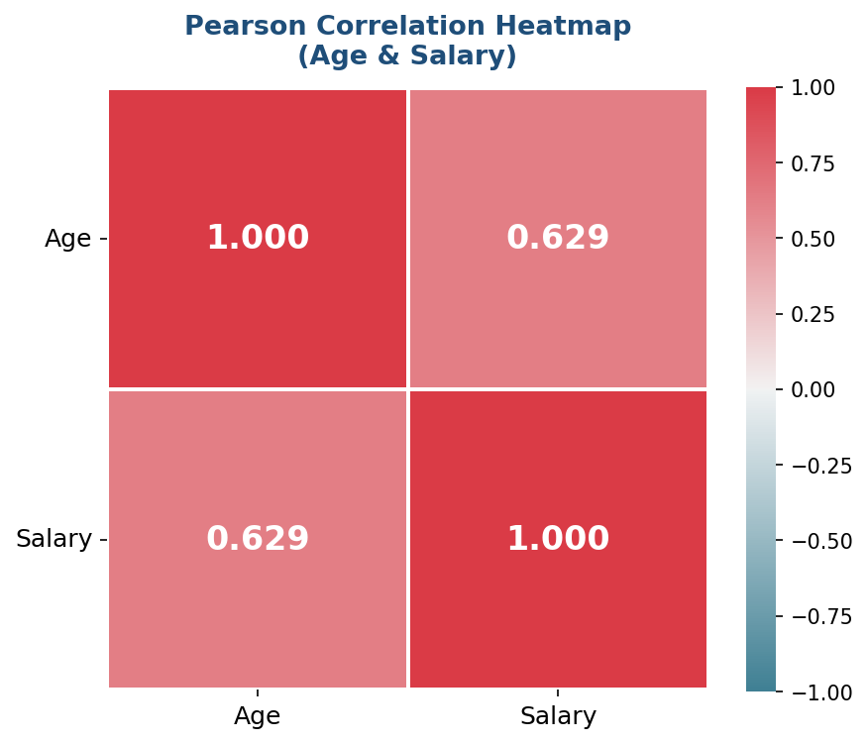
Pearson Correlation — Age vs Salary
r = 0.629
Moderate Positive Correlation
+1.0 Perfect positive
+0.7 to +1.0 Strong positive
+0.4 to +0.7 Moderate ← Our result (r = 0.629)
0.0 No connection
−1.0 Perfect negative
Older employees tend to earn higher salaries
MSE-803 Data Analytics | Week 3 Activity 2

Slide 7
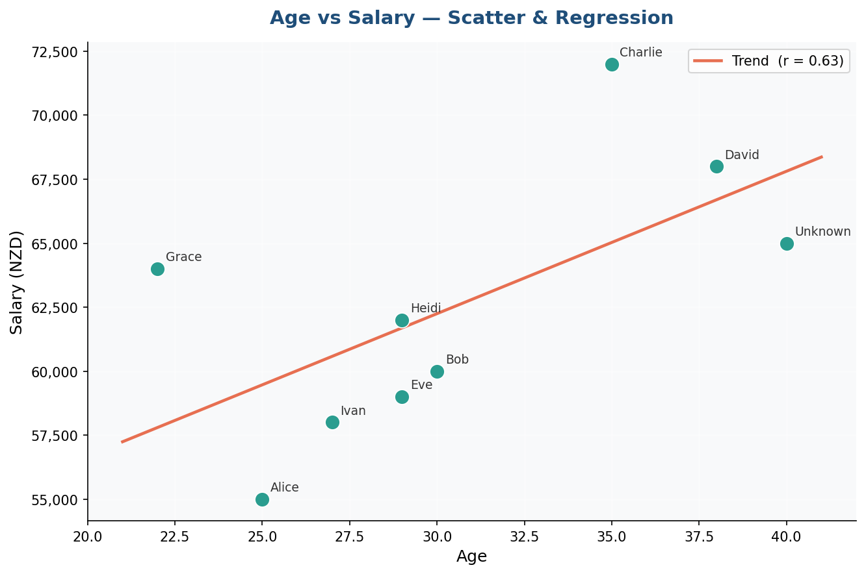
Age vs Salary — Scatter & Regression
Key Points
●
Each dot = one employee
╱
Red line = regression trend
↗
Line goes bottom-left to top-right
r
r = 0.64 shown in legend
✓
Confirms: older → higher salary
MSE-803 Data Analytics | Week 3 Activity 2

Slide 8
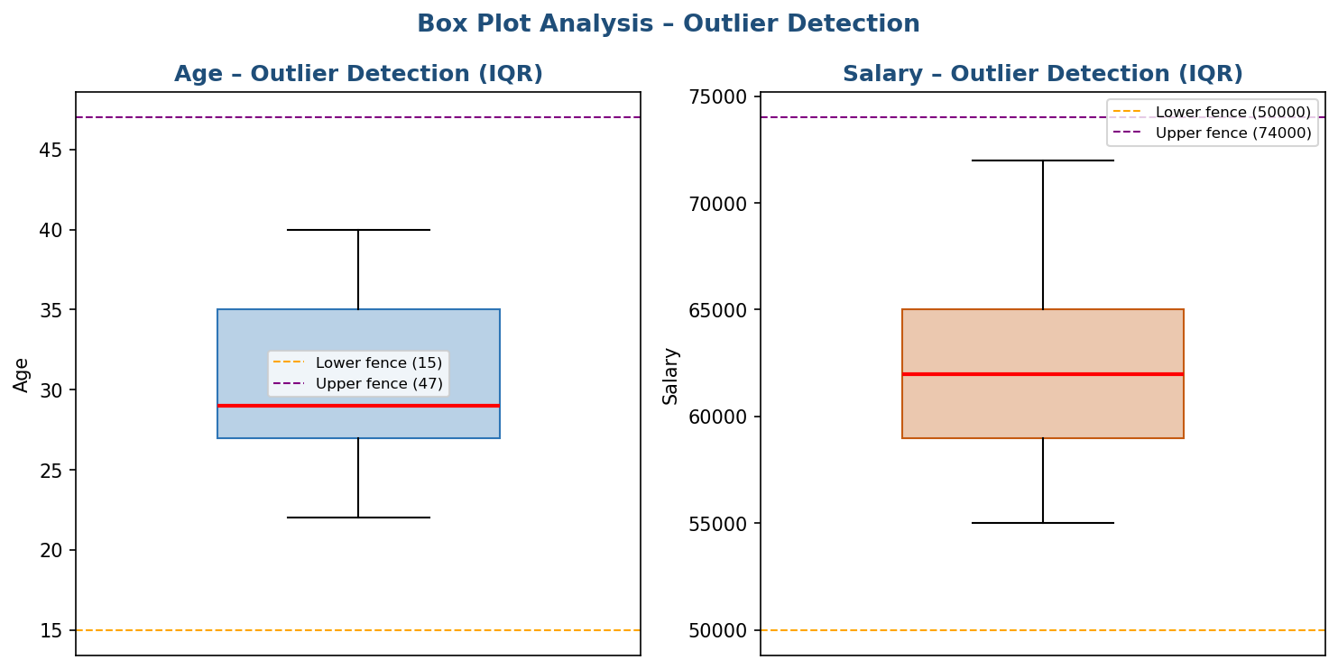
Outlier Detection — IQR Method
IQR Method
IQR = Q3 − Q1
Fence = Q1 − 1.5×IQR to Q3 + 1.5×IQR
Values outside fence = Outliers
Column | Lower Fence | Upper Fence | Outliers
Age | 15.0 yrs | 47.0 yrs | None ✓
Salary | $50,000 | $74,000 | None ✓
✓ ZERO outliers found
in Age or Salary
All values fall within
normal IQR fences
MSE-803 Data Analytics | Week 3 Activity 2

Slide 9
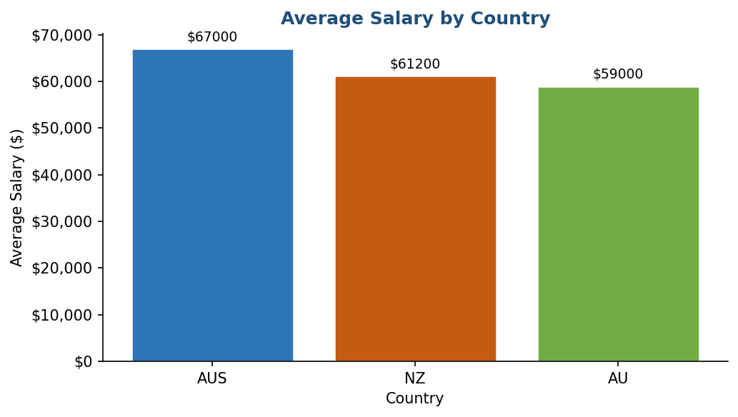
Average Salary by Country
Findings
🥇
AUS
Highest average salary
🥈
NZ
Middle range salary
🥉
AU
Lowest among known
MSE-803 Data Analytics | Week 3 Activity 2

Slide 10
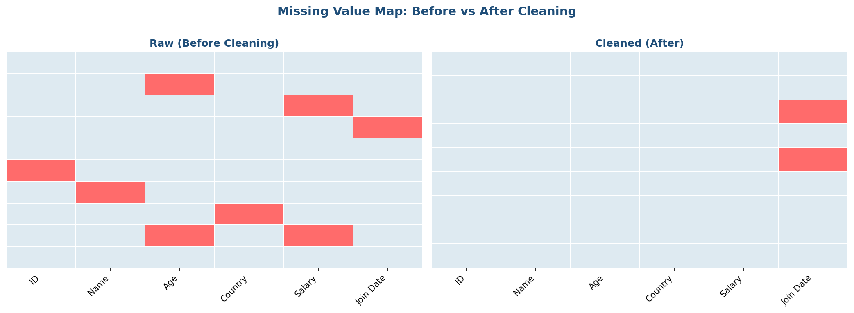
Missing Value Map — Before vs After Cleaning
Red = Missing value
Light blue = Data present
After cleaning: almost no red cells
One Unknown Join Date remains (unfixable)
MSE-803 Data Analytics | Week 3 Activity 2

Slide 11
Excel Workbook — 5 Professional Sheets
Sheet 1
Sheet 2
Sheet 3
Sheet 4
Sheet 5
Raw Data
Issues Log
Cleaned Data
Correlation & Outliers
Visualizations
Original CSV with red cells highlighting problems
Every problem documented with colour coding
Clean 9-row dataset + summary statistics
Pearson matrix + IQR fence table
All 6 charts embedded side by side
Cell Colour Legend
Yellow
Missing value
Pink
Duplicate row
Red
Non-numeric text
Orange
Invalid date
Green
Clean data
MSE-803 Data Analytics | Week 3 Activity 2

Slide 12
Key Findings
✓
Data was messy but fixable — 10 problems found and all fixed with Python
✓
Age and Salary have MODERATE POSITIVE correlation: r = 0.629
✓
Older employees tend to earn more salary
✓
ZERO outliers found — IQR method confirms all values are normal
✓
Australia (AUS) pays the highest average salary
✓
Professional Excel output: 5 sheets, colour coding, all charts embedded
⚠
Warning: Only 9 rows of data — larger dataset needed for stronger conclusions
MSE-803 Data Analytics | Week 3 Activity 2

Slide 13
Conclusion
10 data quality problems were identified and all fixed using Python
Pearson r = 0.629 shows moderate positive relationship between Age and Salary
IQR outlier detection confirms no extreme values in the dataset
6 professional charts were created and embedded in a formatted Excel workbook
The code is clean and modular — each section has one clear responsibility
Lesson: Clean data + correct method + adequate sample size = reliable analysis
Questions?
Pathuma Hiruni | MSE-803 Data Analytics | Yoobee College | 1 May 2026

